Slide 1

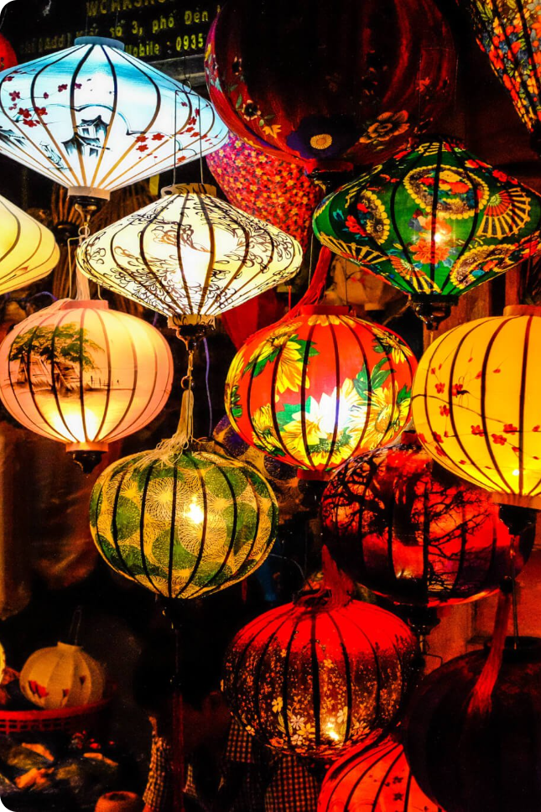
Discovering the Magic of Mid-Autumn Festival
The Mid-Autumn Festival is an ancient Chinese celebration that is centered around family, good food, and sharing. Join us on this journey through the history of the festival.
GW
——Created by Gao Wenjin
——Speech by Liu Renyuan

Slide 2

Content
The Origin of the Mid-Autumn Festival
The Magic of Mooncakes
Mid-Autumn Celebrations around the World
Traditional Mid-Autumn Festival Activities
Myths and Legends of the Mid-Autumn Festival
Modern Celebrations of Mid-Autumn Festival
Conclusion

Slide 3
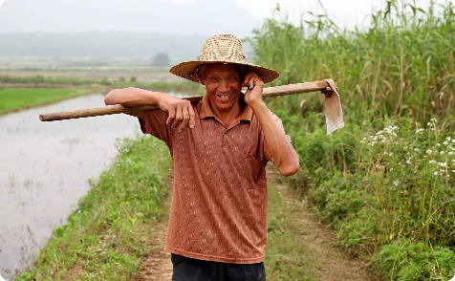
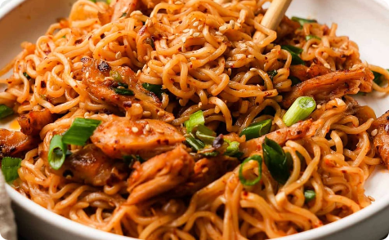
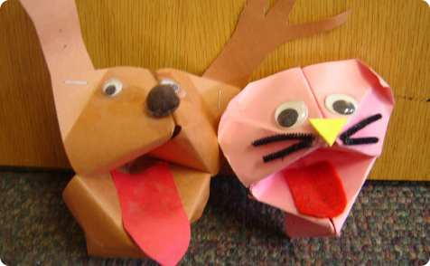
The Origin of the Mid-Autumn Festival
The story of Chang'e
The Moon Goddess and the Dragon
The Ming Dynasty

Slide 4

The Magic of Mooncakes
1
The Symbolic Importance
2
The Many Flavors
3
The History of Mooncakes

Slide 5
Mid-Autumn Celebrations around the World
Vietnam
Korea
Japan
Singapore

Slide 6
Traditional Mid-Autumn Festival Activities
1
Lanterns
Dragon & Lion Dancing
2
3
Tangyuan

Slide 7
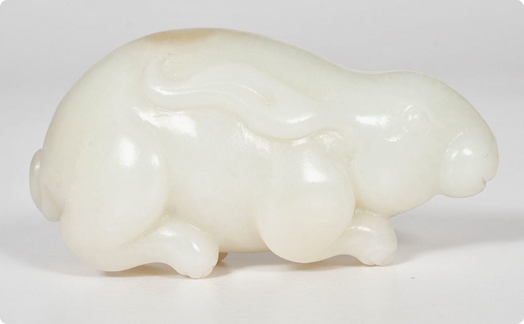
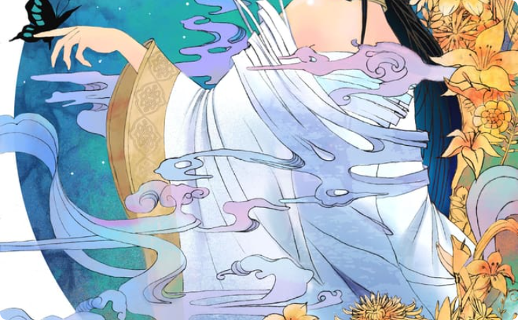
Myths and Legends of the Mid-Autumn Festival
The Jade Rabbit and Mooncakes
The Legend of Chang'e

Slide 8
Modern Celebrations of Mid-Autumn Festival
Online Celebrations
Lighting up the Sky
Gifting

Slide 9
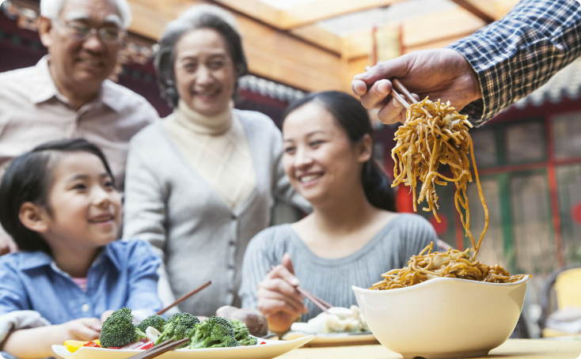
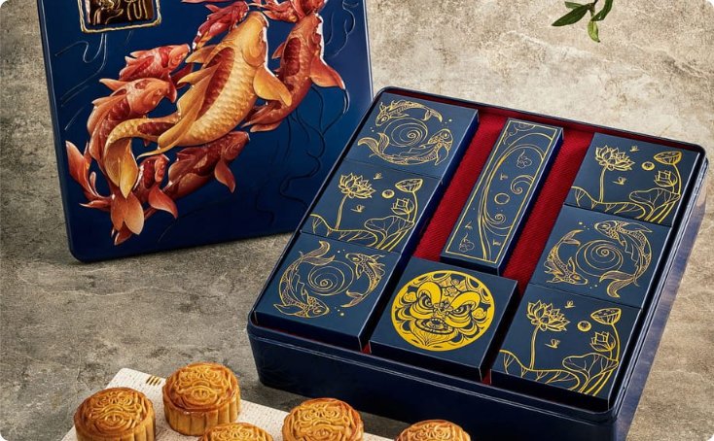
Conclusion
Family and Togetherness
Culture and Heritage

Slide 10
This concludes my speech. Thank you all

